Slide 1
Deep Q Learning
OPER 785: Machine Learning II: Deep Learning
Lecture 13

Slide 2
Setting Our Expectations for Today
Reinforcement Learning was born out of Mathematics. Historically, it is a very math heavy field. We will see some scary equations today
Reinforcement Learning has many different definitions, sub-fields, and perspectives depending on which community you are working within
We will try to be broad and not get too into the weeds
Dr. Robbins teaches multiple classes in this topic
I only can give you enough to be dangerously ignorant
Reinforcement learning is quite different from supervised or unsupervised learning!

Slide 3
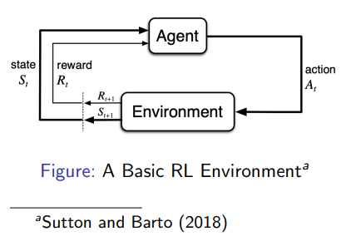
What is Reinforcement Learning?
Agent interactions with the environment by taking actions
In state: S_{t}
Take action: A_{t}
Receive reward: R_{t} (environments feedback)

Slide 4
Agent and Environment
What happens during the reinforcement learning process?
At each time step t the agent
Recognizes that it is in state S_{t}
Executes action A_{t}
Receives a reward R_{t} from the environment
At each time step t the environment
Receives action A_{t} from the agent
Transitions the agent to its next state S_{t+1}
Gives the agent reward R_{t}

Slide 5
Model-Based vs. Model-Free Reinforcement Learning
Powell (2019) describes the difference between model-based and model-free RL as:
Model-based - We assume we have the transition probability matrix P
Model-free - We assume we are working with a physical setting where we can simply observe the transition to state s’ without a transition matrix

Slide 6
More Components of Reinforcement Learning
Policy, π
Tells the agent which decision (i.e., action) to take depending on its current state
Value function, V (or Q)
Evaluation of how good each state and/or action is (the value of the quality)
V for model-based and Q for model-free (typically)
Model
Agent’s representation of the environment – the transition probability matrix P

Slide 7
Markov Decision Processes
A Markov Decision Process is a tuple (T, S, A_{s}, p, r), where
T is the amount of decision epochs (time steps)
S is the set of all possible states
A_{s} is the set of all possible actions depending upon our state, s ∈ S
p(s′|s, a) is the probability of transitioning to state s′ given we are in state s and take action a
r(s, a) is the expected reward received when in state s and choosing action a

Slide 8
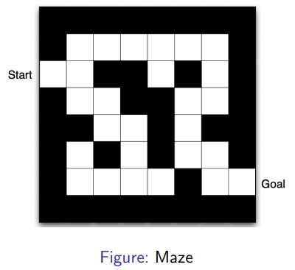
Maze Example
States: Each square is in the set S
Actions: N,E,S,W - whichever is possible for each state (A_{s})
Rewards: -1 for each time step

Slide 9
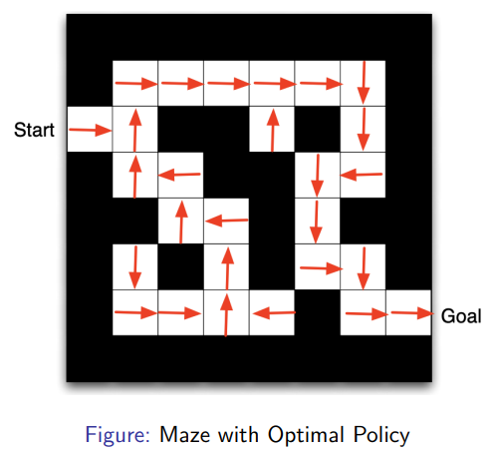
Maze Example: Optimal Policy

Slide 10

Bellman: Optimality Equations²
The goal of reinforcement learning, in a nutshell, is to find an optimal policy, written as π, a sequence which gives the best decision (i.e., action) for each state of the system in order to maximize total expected reward
How “good” a policy, π, is, is defined by the value function:
We want the policy that gives us the optimal value function defined as:
Notice, we have a “discount factor”, γ. We prize present rewards over
later future rewards.
² Bellman (1952)

Slide 11
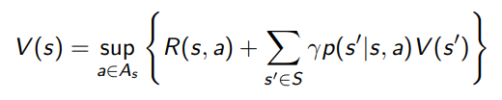
Bellman Optimality
The goal of classic reinforcement learning is to solve the equation:
where each action that is best for each state is stored in our optimal policy π

Slide 12



Reinforcement Learning Algorithm
Initialize v⁰, specify ε>0, and set n=0
For each state s, compute v^{n+1}(s) by
If
For each state s, choose
3 Puterman (2014)

Slide 13
This is Deep into the Dark Arts
More often than not:
Traditional methods require an “exact” solution that is incredibly computationally inefficient if the state/action space is large
The transition probabilities are unknowable/too difficult to model
Thus, we cannot use an MDP model
Thus, we will not be able to get the exact value functions of our state-action pairs
New objective: with this in mind, do the best we can and use approximate methods

Slide 14
We’ve Arrived at Q Learning
Introduced in a 1989 PhD Dissertation (Watkins, 1989)
Named after the variable Q(s, a), which is an estimate of the value of being in state s and taking action a
Q(s, a) is essentially the value of a state-action pair
Does it receive high reward or not?
Model-free RL algorithm, updates the value function and searches for the near-optimal policy without explicitly modeling the environment - no transition probability matrix!

Slide 15

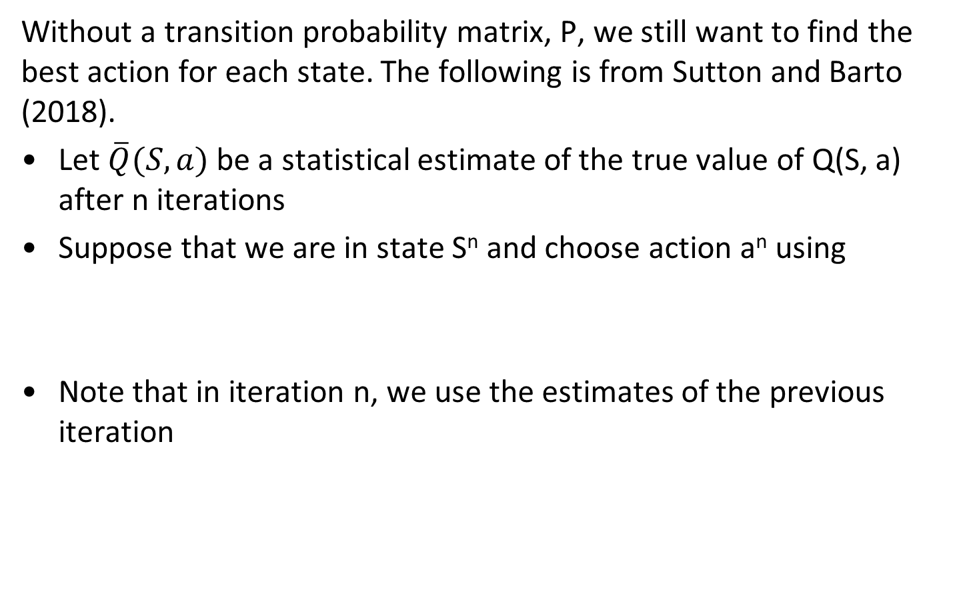
Theory Behind Q-Learning
Without a transition probability matrix, P, we still want to find the best action for each state. The following is from Sutton and Barto (2018).
Let $\overline{Q}(S, a)$be a statistical estimate of the true value of Q(S, a) after n iterations
Suppose that we are in state S^{n} and choose action a^{n} using
Note that in iteration n, we use the estimates of the previous iteration

Slide 16

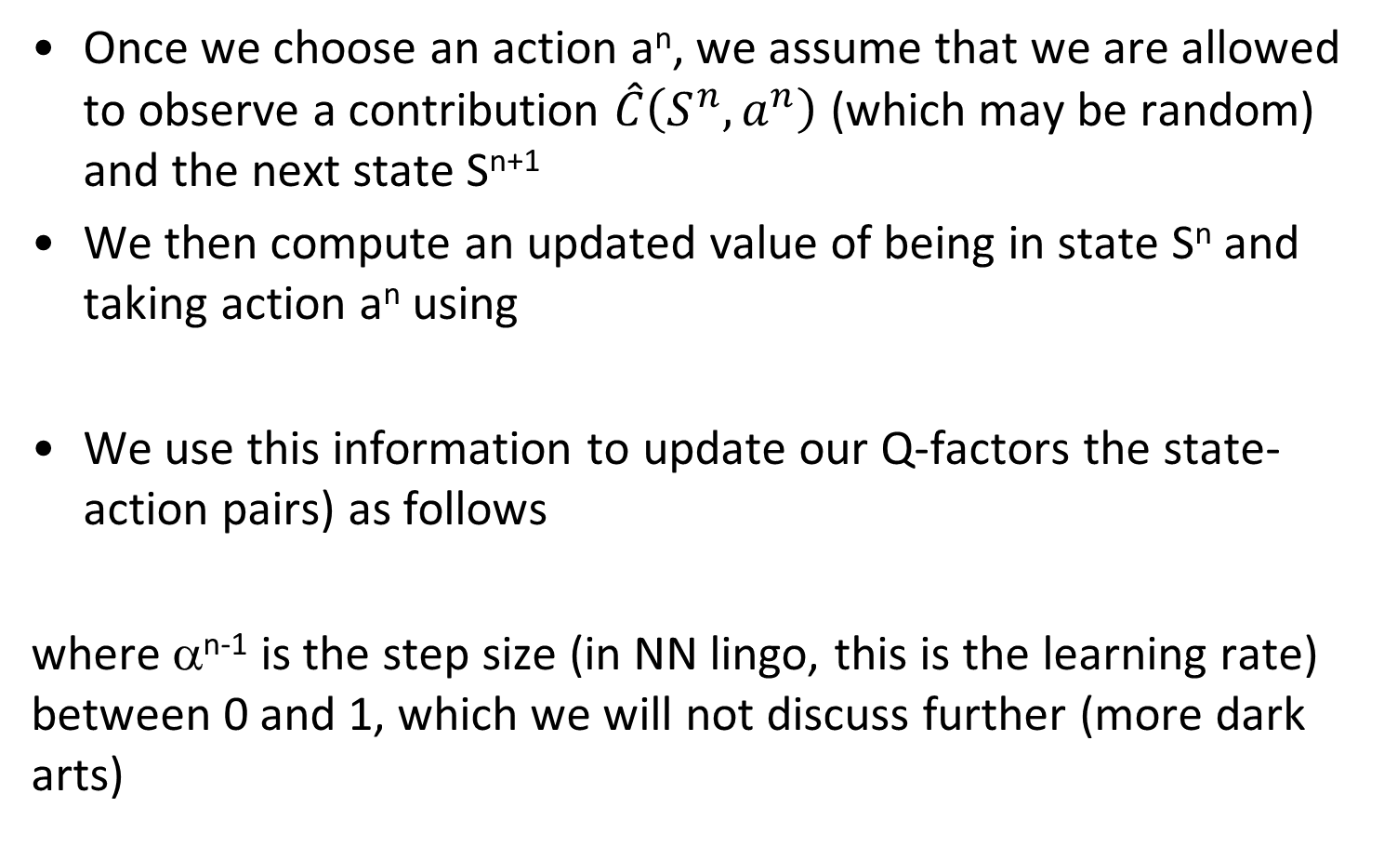
Q-Learning Theory (cont.)
Once we choose an action a^{n}, we assume that we are allowed to observe a contribution $\hat{C}\left(S^{n},a^{n}\right)$ (which may be random) and the next state S^{n+1}
We then compute an updated value of being in state S^{n} and taking action a^{n} using
We use this information to update our Q-factors the state-action pairs) as follows
where α^{n-1} is the step size (in NN lingo, this is the learning rate) between 0 and 1, which we will not discuss further (more dark arts)

Slide 17
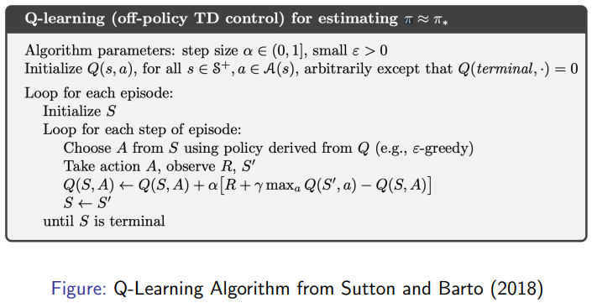
Q-Learning Algorithm
The agent’s learning consists of a sequence of episodes. In the n^{th} episode the agent:
Observes the current state S
Selects and performs an action a
Observes the subsequent state S′
Receives an immediate reward R
Adjusts its Q^{n}(S, a) values using the learning factor α

Slide 18
Q-Learning Issues
Complexity:
Can only model small and discrete action spaces
Cannot model continuous action spaces
Flexibility:
Policy is determined by maximizing the reward of the Q-function
Cannot learn stochastic policies
Andrej Karpathy, Senior Director AI at Tesla said, “Supervised learning wants to work, Reinforcement learning must be forced to work”

Slide 19
References
Bellman, R. (1952). On the theory of dynamic programming. Proceedings of the National Academy of Sciences 38(8), 716–719.
Mnih, V., K. Kavukcuoglu, D. Silver, A. A. Rusu, J. Veness, M. G. Bellemare, A. Graves, M. Riedmiller, A. K. Fidjeland, G. Ostrovski, et al. (2015). Human-level control through deep reinforcement learning. Nature 518(7540), 529–533.
Powell, W. B. (2019). A unified framework for stochastic optimization. European Journal of Operational Research 275 (3), 795–821.
Puterman, M. L. (2014). Markov decision processes: discrete stochastic dynamic programming. John Wiley & Sons.
Sutton, R. S. and A. G. Barto (2018). Reinforcement learning: An introduction. MIT press.
Watkins, C. J. C. H. (1989). Learning from delayed rewards. Ph. D. thesis, University of Cambridge, England.

Slide 20
Questions

